Slide 1
Modelling and Detecting Long Memory in Stock Returns
  Doctoral School of Finance and Banking
  Academy of Economic Studies Bucharest
MSc student Ciprian Necula

Slide 2
Presentation contents
modelling and detecting long memory in time series
data, methodology and empirical results
a continuous trading model with long memory
pricing derivative securities in presence of long memory

Slide 3
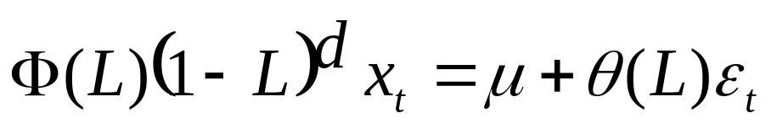
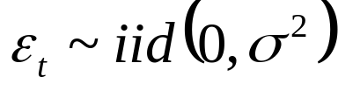
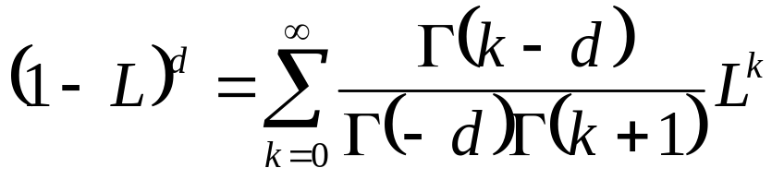

Modelling long memory
ARFIMA(p,d,q)
the differencing parameter can take any real value
where is Euler’s gamma function

Slide 4


Hosking (1981) shows that
    if and the roots of are outside
the unit circle the process is stationary and invertible
    the autocorrelations of such a process decline at a
hyperbolic rate to zero, a much slower rate of decay than the
exponential decay of the ARMA process
    for positive d the sum of the absolute values of the
autocovariance function is infinite; this is the case of long memory
or long range dependence

Slide 5

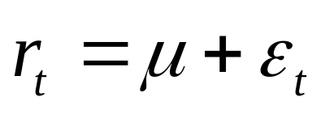
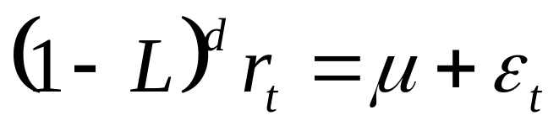
Consider now a time series of stock returns
Starting form the classical model:
we will focus on the model:

Slide 6
Consequences of the long memory property:
  the presence of long memory in asset returns contradicts
the weak form of the market efficiency hypothesis, which states
that, conditioned on historical returns, future asset returns are
unpredictable
  Mandelbrot (1971) suggests that pricing derivative securities
with martingale methods may not be appropriate if the underlying
follows a continuous stochastic process that exhibits long memory

Slide 7
Testing for Long Memory
ADF – null hypotesis I(1)
Diebold and Rudebusch (1991) and Hassler and Wolter (1994) find that ADF tests tend to have low power against the alternative hypothesis of fractional integration
KPSS – null hypotesis I(0)
Lee and Schmidt (1996) show that KPSS test can be used to distinguish short memory and long memory stationary processes

Slide 8
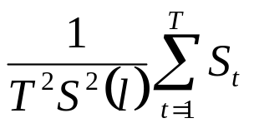
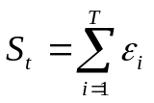



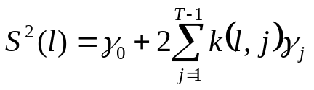

KPSS(1992)
Kpss statistics:
where and is the residual from regressing the series
against a constant or a constant and a trend.
is a consistent estimator of the “long run variance” of ,
where and is a kernel function depending on the bandwidth parameter l.
kernels: the Bartlett kernel and the Quadratic Spectral kernel.
a data dependent procedure to estimate the optimal bandwidth parameter l ,
approach explored by Andrews (1991) and Newey and West (1994)

Slide 9



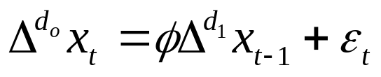


FDF
Donaldo, Gonzalo and Mayoral (2002) proposed a Fractional Dickey-Fuller
test (FDF) for testing the null hypothesis of against the alternative
hypothesis .
FDF is based on the t-statistic of the OLS estimator of in the regression:
If then

Slide 10



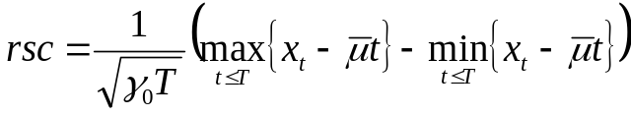
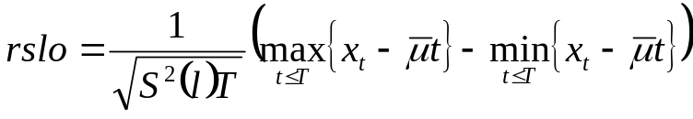
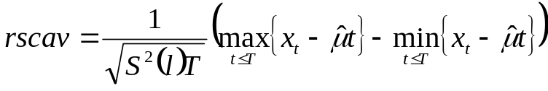





R/S test
Let and let be the OLS estimator of the coefficient of the trend
from regressing the series against a constant and a trend
the classical R/S statistic:
Lo(1991) generalized R/S statistic:
Cavaliere (2001) generalized R/S statistic:
where is the usual estimate of the variance of the series
and is a consistent estimator of the “long run variance” of
the null hypotesis against ,

Slide 11
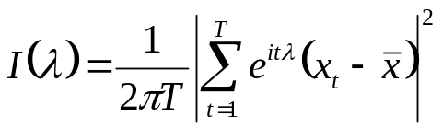


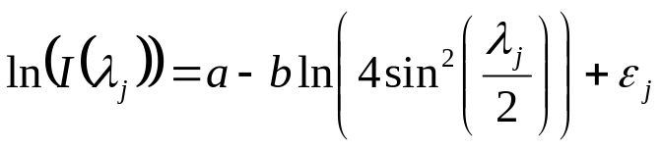


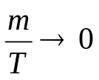


Estimating the degree of fractional differencing
Log Periodogram Estimator
Consider peridogram of a series :
Geweke, J. and S. Porter-Hudak(1983) proposed as an estimate of
the OLS estimator of from the regression:
the bandwidth is chosen such that for , but
perform tests both using the t ratios based on the standard deviations
of the regression and using the aymtotic distribution obtained by
Robinson (1995a)

Slide 12
Approximate MLE estimators
Sowell (1992) derives an exact Maximum Likelihood Estimator
of the ARFIMA(p, d, q) process. However the Sowell estimator
is computationally burdensome
In this paper we used two approximate MLE estimators:
approximate Whittle estimator proposed by
Fox and Taqqu (1986)
an approximate wavelet MLE proposed by Jensen (2000)

Slide 13
Data, methodology and empirical results
7 international indices: United States – S&P500 Index and
NASDAQ Index; France - CAC40 Index; United Kingdom –
FTSE100 Index, Japan -Nikkei 225 Index, Singapore- Straits Times
Index, Taiwan - Weighted Index
3 Romanian indices: BET, BETC, RASDAQ
periods up to June 2002

Slide 14
The tests and the estimation are implemented in Mathcad 2000
The estimation procedures require either the peridogram or the
wavelet coefficients. These are in fact the Fourier Transform and
the Wavelet transform of the data series. Since the algorithms
implemented in Mathcad to compute this two transforms
(Fast Fourier Transform respectively Fast Wavelet Transform)
requires that the number of inputs be a power of 2 ,
we have to reduce our samples to the largest power of two.
The tests procedures proved to be a much bigger burden for
the computer than the estimation procedures. So, due to lack
of computing power, when conducting a test we reduced the
sample size up to 2000 observations

Slide 15
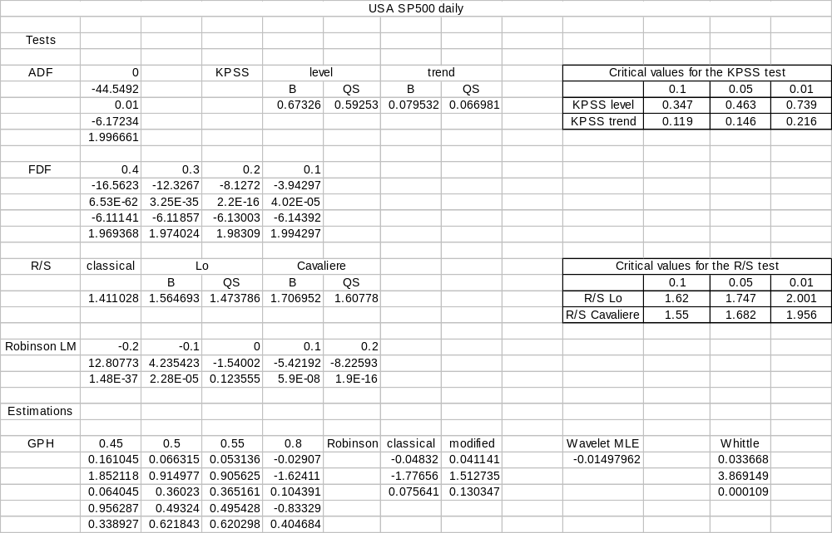

Slide 16


Slide 17
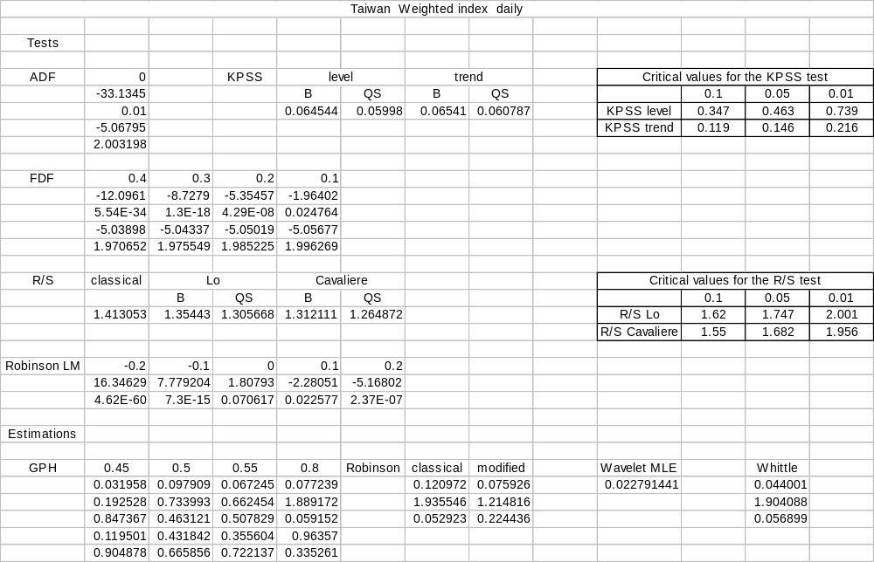

Slide 18
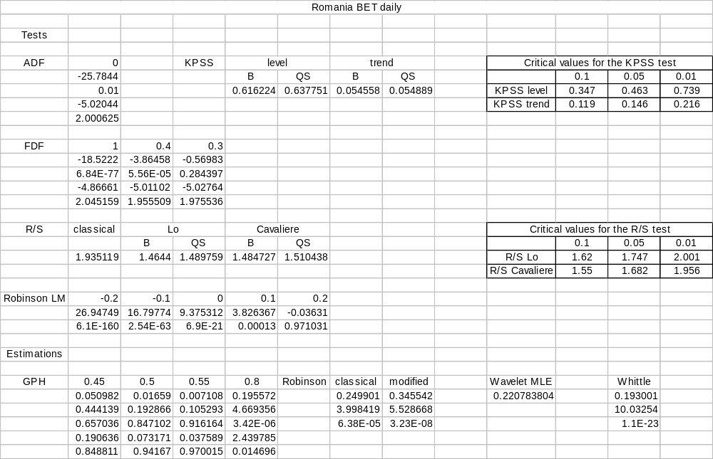

Slide 19


Slide 20
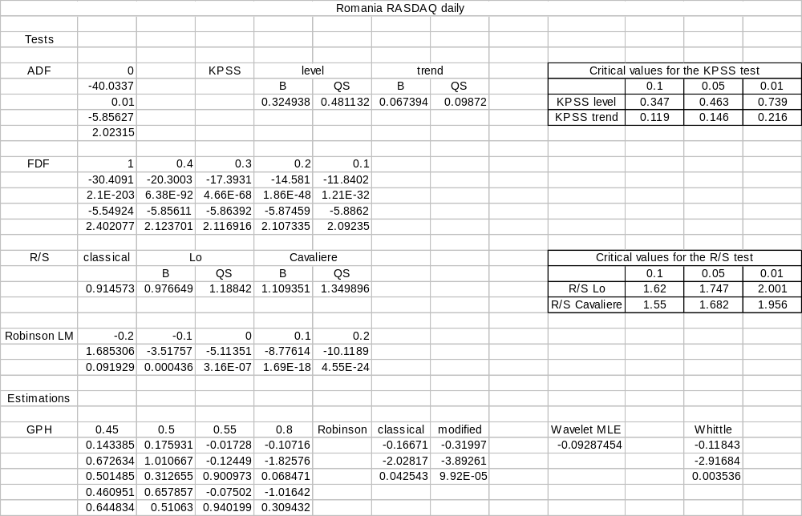

Slide 21




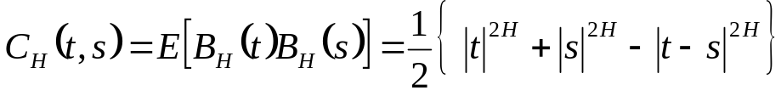



A continuous trading model with long memory
Fractional Brownian Motion
If the fractional Brownian motion (fBm) with Hurst parameter H is
the continuous Gaussian process , with mean
and whose covariance is given by:
The Hurst parameter determines the sign of the covariance of the future and past
increments. This covariance is positive when , zero when and
negative when .
for the fractional Brownian motion has long range dependence

Slide 22

Since for the fractional Brownian motion is neither a Markov process,
nor a semimartingale, we can not use the usual stochastic calculus to analyze it.
Lin (1995) developed a pathwise integration theory for fractional Brownian motion
and Rogers (1997) proved that the market mathematical models based on this
integration theory can have arbitrage
Duncan, Hu and Pasik-Duncan (2000) and Hu and Oksendal (2000) introduced
a new kind of integral, a generalization of the Ito integral, called fractional Ito
integral. They derive a fractional Ito lemma, and introduced two new concepts:
quasi-conditional expectation and quasi-martingale

Slide 23

A fractional Black-Scholes market
Let .Consider a fractional Black-Scholes market that has two
investment possibilities:
  a money market account
where r represent the constant riskless interest rate
stock whose price satisfies the equation
Where are constants

Slide 24

Hu and Oksendal (2000) have shown that this market does
not have arbitrage and is complete.
They compute the risk-neutral measure and under this measure
we have that:
A formula for the price of a European option at is also
derived

Slide 25



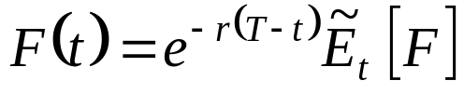
Pricing derivative securities
We will denote by the quasi-conditional expectation
with respect to the risk-neutral measure.
Necula(2002) have shown that in a fractional Black-Scholes market
we have the following results:
Theorem 1 (fractional risk-neutral evaluation)
The price at every of a bounded claim is given by

Slide 26



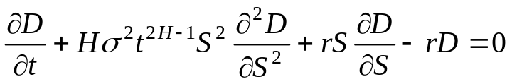

Theorem 2 (fractional Black-Scholes equation)
The price of a derivative on the stock price with a bounded payoff
is given by , where is the solution of the PDE:

Slide 27


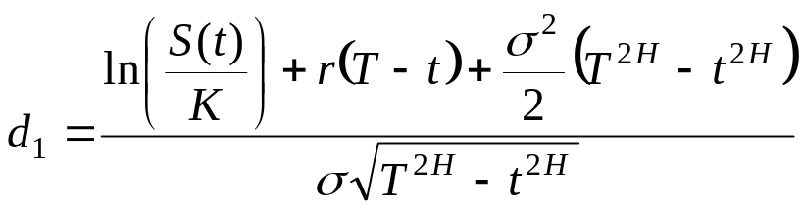
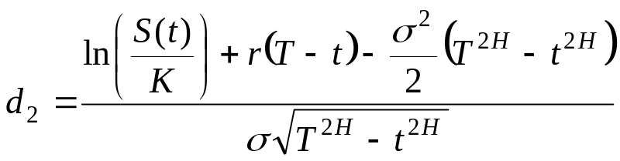

Theorem 3 (fractional Black-Scholes formula)
The price at every of an European call option with strike
price is given by
where is the cumulative probability of the standard
normal distribution

Slide 28
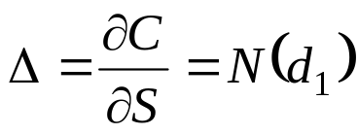
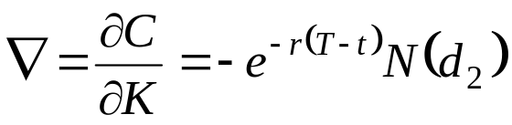
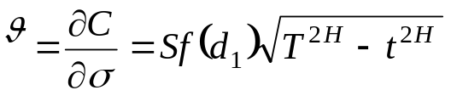
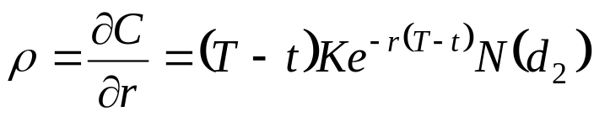
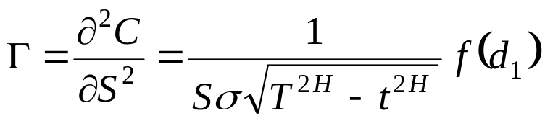
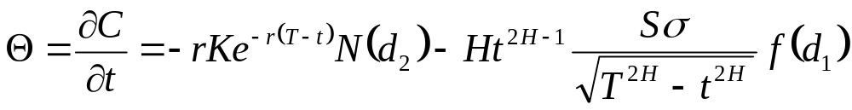
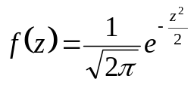
Theorem 4 (The Greeks)
where

Slide 29





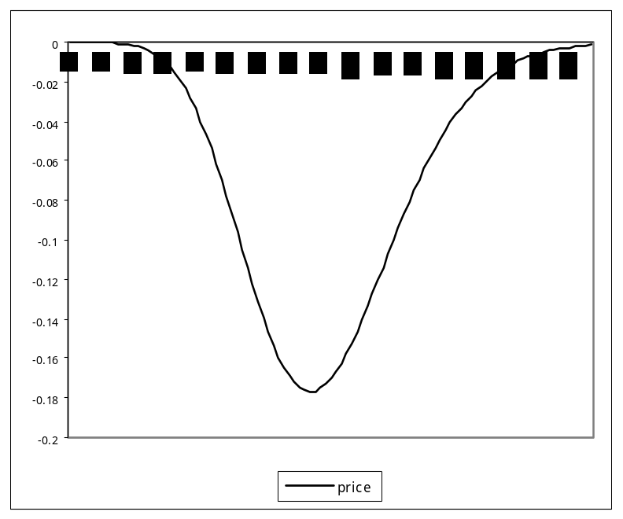
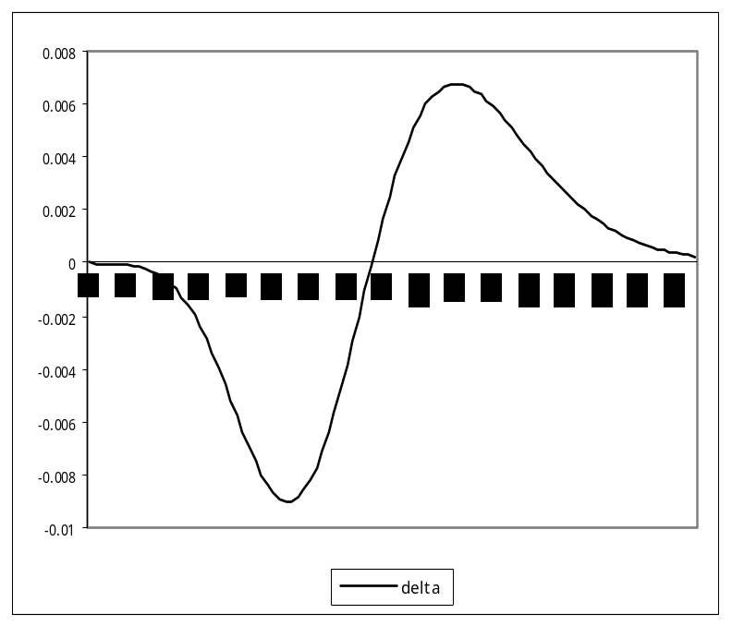

Slide 30
Conclusions:
Using a wide range of test and estimation procedures we have
investigated whether stock returns exhibit long memory. Some
evidence of long range dependence was found in daily returns of
S&P500, NASDAQ, FTSE100, Singapore ST and Taiwan WI
indices and in weekly returns of Nikkei 225 and Singapore ST
indices. Strong evidence of long memory was found in daily returns
of Romanian BET and BETC indices.
If the underlying follows a continuous stochastic process that
exhibits long memory, pricing derivative securities with martingale
methods it is not appropriate.

